Slide 1


Shaping the Adult Social Care market: Luton’s Market Position Statement
January 2021

Slide 2
Executive Summary (1)
Introduction
This updated Market Position Statement gives a view of the provision of Adult Social Care Services and support in Luton, and our understanding of current need as well as estimated future need.
This is and must be a live document: the need and demand for adult social care is always dynamic, and this is especially true during the Covid-19 pandemic which we know is having and will continue to have a profound effect on our population and their need for adult social care and consequently on our market providing adult social care services and support. The nature and scale of significant changes in our demographics, people’s needs and expectations, legislation and financial pressures requires us to work differently and more sustainability to help those with social care needs, their families and carers to have a better quality of life. We aim to have a community based operating model for our adult social care services, with our Side by Side programme focusing on strength-based conversations and collaboration with people, their families and carers.
Luton Borough Council’s shared vision for Luton 2040 is of:
  a town built on fairness, where our residents can reach their full potential and our strong and diverse community can support all our people to enjoy a good quality of life. Luton will be a vibrant, resilient and sustainable town where we work together to ensure no-one has to live in poverty.
We want to ensure that our adult social care services and support serve our vision for Luton 2040. We want our strong and diverse community to be inclusive and accepting of all people, and for all adults, whatever their physical or mental health needs, to reach their full potential. This includes having services that can support the range of personal needs of an individual, whether that relates to language, or religious observances, or dietary requirements. And it includes having people with the range of physical and mental health needs we see in Luton as an integral part of our community.
A recent Healthwatch report (2019) showed that Luton residents from Asian ethnic groups were three times more likely to rate easy access to the information I need to help me make decisions about my health and care’ as more important than Luton residents from White British groups. We need our social care support to be relevant and accessible to everyone.

Slide 3
Executive Summary (2)
The aims of Luton’s Social Care Delivery Model are to:
To change the culture in ASC to focus more on people’s strengths, gifts, assets. We want to ‘listen hard’ to understand what matters to people, not what is the matter with people. We see neighbourliness and neighbours as the ‘glue’ that holds people and communities together.
To bend the curve of demand and constrain costs.
To improve the experience in the adult social care journey, eliminating queues, waiting lists and lengthy form led assessments
We have already seen evidence of this new strategy delivering change: with positive change in staff behaviours and feedback, improved information flow with soft intelligence to support decision making. And importantly, people using the services have given great feedback and queues and waiting lists have reduced – bringing tangible direct benefits to people needing adult social care support. We also seen evidence that early intervention and prevention, better triaging and more effective signposting, is reducing the level of activity required in long term care and complex case management. We will continue to embed the Three Conversations model in to the Council’s ways of working and culture. We know that particular in areas such as commissioning for the third sector and Local Area Coordination, we need to do more work and this will be a focus over the next 12 months.
Challenges ahead
The COVID-19 pandemic has profoundly impacted the physical and emotional health of our population in Luton, and will bring significant economic ramifications which will impact at an individual, community and system level. The Covid-19 emergency has caused fundamental changes to the Council’s budget and in its Emergency Budget agreed by the Full Council on 14th July, the Council required £22m savings to balance the budget over 20/21 and 21/22. These figures will be further revised as part of budget setting process in 21/22. We will focus on a proactive work plan and maintain our shift towards more preventative ways of working. The savings plan within Adult Social Care is likely to impact across the breadth of our services: we will monitor the assessment of the impact and our likely to need to respond, adapt and review as an ongoing approach.
A focus on value for money will be a priority across our adult social care market, as we look to ensure quality in our services but reduce waste. For example, just in the area of learning disability and autism spectrum disorder we currently fund 33 out of borough placement because we do not have adequate provision for those individuals in our town. This is likely to have a psychological as well as financial impact on those individuals and their families in visiting and maintaining their relationship, and it also places a significant costly burden on the Council. Much of this is preventable with sufficient appropriate provision within our own borough. We recognise we will need to continually monitor our delivery, to ensure these plans can be achieved with the continuing impact of COVID-19 including the impact of efficiencies on our staff capacity.

Slide 4
Executive Summary (3)
In the next year, Luton Borough Council will be reviewing its transport assistance service (across children’s services, Special Educational Needs and Disability and adult social care) to identify improvements and address inefficiencies within the programme.
Priorities for adult social care
Luton Borough Council has identified 8 priorities to take forward across Adult Social Care; these can only be achieved through working closely with the adult social care market as well as other stakeholders including Luton Clinical Commissioning Group (CCG). In addition to these 8 priorities, we have set out for each service area, or group of people who receive adult social care, what direction and activities we are planning to take over the next three financial years to develop our services in that area. There are areas where our strategy is clearly defined and implementation will be the focus – for example, to support people with learning disabilities and improving support for those transition from children’s to adults social care services. Luton’s SEND strategy includes a priority to improve transition and opportunities for 16-25 year olds with a Written Statement of Action for delivery. There are other areas where we will first need to co-produce a strategy - for example, for people with neurodiversity and for carers - and this will be the initial focus in order to agree and determine the most important next steps.
Working together
Having an adult social care system that enables our residents to live to their full potential requires a coordinated approach across Council departments as well as with external stakeholders, including the CCG, our adult social care market and the voluntary and community sector who play such a vital role in delivering community support and infrastructure. We also need to ensure close engagement with our service users and their networks, whether families, friends or formal carers. We know that there are some areas within adult social care where we do that well, and we know that there are some areas where we need do that even more effectively.
We will work to routinely bring together colleagues in Commissioning, Adult Social Care, Public Health, Children’s services, Housing and Social Justice to have a proactive approach to planning care provision and support. This will help understand and anticipate current and future demand – for example, improving our transitions between children’s and adults’ services. We currently have a number of Partnership Forums in place that bring together people affected by a particular issue. We want to see these develop with co-production at their heart. The Dementia Action Alliance is an example of where this works well.
Our response to Covid-19 has stimulated closer working across and within agencies and organisations. For example, regular Provider meetings for the residential and nursing care market to provide updates, create space for discussion and emerging priorities and give notice for any changes planned. We know that many organisations and providers within the market are working more closely with each other, to respond to the urgent need to support our most vulnerable affected by Covid-19. We want to build on this progress, and maintain this collaborative approach.

Slide 5
Our 8 priorities for Adult Social Care: 1 & 2
1. Manage the impacts of Covid-19 with resilience planning across social care
The impact of Covid-19 across Luton’s population, and the Council’s services, is already being felt but we can’t know yet the full extent of it. Some ASC services, such as day centres, have had to close temporarily and we know that will have had a direct impact on our informal carers, who will experience even greater demands on their physical and mental resources to support their loved ones. We know the significant pressure that our residential and nursing homes have been under, and have been working closely with them throughout this period to help them to best support our vulnerable populations. We anticipate that there will be a long-term impact on both the need and demand for adult social care support, across the board. For some, there are already issues with under-occupancy and the challenges to financial stability that go with that. For others, there will be longer-term implications for the demand on services – either a reduction or an increase. We know that the strain on our mental health provision has been significant, and that is likely to continue at least in the short term.
We will need to scope, model and estimate the impact of Covid-19 across ASC and develop resilience plans for the range of services likely to be most affected. This will involve our commissioning, care management and quality teams and we will need to draw on some of Luton’s wider population health strategic ambitions to consider how we respond as a Council.
2. Support people to live at home independently for as long as sensibly possible
We know that the majority of people want to say in their own homes for as long as possible, or to be supported to live independently through housing-related support. For some, this will be about small interventions that act as a preventative measure. For example, linking them to support mechanisms within the community through programmes like Side by Side, or through our frailty project which reaches out to those people who are mild or moderately frail to support with adaptations or support to keep them well. Avoiding preventable admissions is critical, but where short term admissions do take place, we want to prioritise safe, early discharge and successful completion of rehabilitation programmes. For others, the role of digital and technology is likely to be important.
We are interested in exploring digital solutions to promoting independent living, from medication reminders to digital alarm monitoring systems to assistive devices. We want to encourage more people eligible to receive direct payments and personal health budgets, to choose how best to support themselves to live independently. For example, for some people with dementia purchasing the support of a PA can transform their day to day lives and help them continue to pursue their interests.
We know that informal carers play a significant role in support people to live independently at home, and the pressure on them has increased during Covid-19. We will co-produce a carer’s strategy to ensure we are supporting our carers and preventing burn-out amongst those providing an incredible support.

Slide 6
Our 8 priorities for Adult Social Care: 3 & 4
3. Testing new approaches to delivering home care
Appropriate and quality home care is a critical component of supporting people to live at home independently, including the effective use of digital technology. We need to understand how home care can work effectively to support increased number of people to continue to live independently. We anticipate that there could be a decrease in home care needed if we get things like reablement support and early preventative interventions through community approaches right. We are interested in exploring principles like those in the Buurtzorg model of home care, integrating health and social care approaches in the community. We will work with Luton’s CCG to consider how community health and social care can complement a shared aim of supporting people to live as independently as possible.
Introducing and expanding digital and assistive technologies to our home care provision in Luton will bring benefits and reassurances to those receiving home care, as well as their families and carers, and it can also bring efficiencies as well as help identify needs quickly.
4. Ensure Luton has the right supply of appropriate housing and accommodation for its changing demographic
While Luton has a comparatively young population, the overall population is growing and the number of people aged 65+ years is projected to rise by 38% in the next 15 years to 38,400 people by 2035. In addition, we have a growing population of people aged under 65 years who are managing physical and or mental health conditions which mean they may require housing or accommodation support.
We want to work upstream, acting preventatively to stop avoidable accommodation or housing crises. However, we recognise that there will also be need and we want to ensure that people get appropriate support that meets their specific needs. We know that, for example, some of our sheltered housing stock is not sufficiently accessible. We also know that we struggle to place people with complex needs, particularly with some physical impairments, in housing support within Luton leading to a high number of out of borough placements particularly for people with learning disability. We will ensure that a specific quota of our housing stock is ring-fenced for people with adult social care needs, to enable more rapid and appropriate provision for people with specific needs within our existing stock.
In Luton, we are rolling out Housing First, an initiative to provide housing and personal support to homeless people with complex needs. We are committed to reducing homelessness through ensuring appropriate hostel provision and access to sheltered housing. The Luton Homeless Partnership and Penrose synergy is a great example of this. We want to build on and develop best practice approaches to addressing the challenge of homelessness, which we know has become an increasing issue given the wider impact of the Covid-19 pandemic.

Slide 7
Our 8 priorities for Adult Social Care: 5 & 6
5. Maintain and extend the expanded use of technology across social care settings
There is a wide range of possible technological innovations that could be tried and tested across social care settings. And there are assistive technologies and small innovations that are now well-established and proven that should be becoming business as usual. We believe both are important, but we know we still have some way to progress in securing the ‘bread and butter’ of technology is in place in Luton and being used well. We want to focus there, with a view to expanding to broader innovations in the longer term.
In some ways, Covid-19 has forced our hand towards more innovative approaches to communication and monitoring – and this has brought some great advantages. We know technology is not a replacement to important face to face support, but it can be a great complement to it. We want our care providers to be using tools like the Canary Assessment, or for our community teams to be linking with providers and professionals using things like iPads, delivering immediate and tailored support in an efficient way. We think direct payments can be used to support independence through technology, and are keen to look at best practice and implementation in this area.
6. Ensure Value for Money to contribute to Luton’s economic recovery plan
Luton’s financial position is challenging. The impact of Covid-19 on London Luton Airport Limited is acute, and as a result there will be a knock-on effect on funding of a number of sectors and services, particularly amongst the voluntary and community sector.
The Council has already set in train a number of changes in adult social care, in line with a savings directive. Consistent due diligence across all services, including new providers, will be important to not only ensuring quality but also focusing on value for money. We know that our overall placements process and activity has some areas of inefficiency which we will need to address - this includes the way in which our transitions arrangements work. We will move to align our approaches to frameworks and due diligence across children’s and adults’ services. We also know that we support a significant number of people out of borough at a much higher cost than we believe necessary if we had the appropriate provision for them within Luton. Returning people to Luton safely and sustainability will be a big priority for us over the next two years.

Slide 8
Our 8 priorities for Adult Social Care: 7 & 8
7. Support a coordinated and preventative approach to people with mental health and substance misuse issues
Supporting people with dual diagnosis and complex life stories lives is a high priority across the Council. We recognise the complexity of the commissioning arrangements of mental health and substance misuse services within the Council and wider partners and that these require a joined up approach and close working with the different providers involved in a person’s support journey.
We want to build on the mental health strategies underway across Luton, Bedfordshire and Milton Keynes, such as Luton’s Reimagining Mental Health, and ensure a close alignment with adult social care services. For example, we have a good system in place across different teams to communicate about the needs of individuals with learning disability who are likely to require placements or support as circumstances change and needs arise. However, we know that our pipeline for communication about the emerging needs of people with complex mental health conditions is not so developed. We want to establish good working relationships and processes across the Council, with other commissioners and with providers that will see support joined up, to ensure preventative and timely support.
8. Support quality through strengthened quality assurance processes and developing the social care workforce
We know that ensuring quality will require working closely with the adult social care market to understand how best the Council can support quality improvement approaches. We are revising our quality assurance processes, to have a more holistic approach to service quality reviews and to clarify and strengthen our escalation processes. We will work in partnership with providers to enhance the quality of people’s care and to address issues where services are inadequate or need improvement.
We have a high turnover of staff in our social care workforce; we want to support skill development to improve workforce retention. This will range from upskilling care workers with some elements of nursing care (through exploring nursing apprenticeships) to supporting management development to ensuring that relevant care settings have specific trainings appropriate for the people using their services – for example, all care home staff to receive dementia awareness training. We want to develop and retain good staff within Luton; this is vital to delivering good quality care to our population who receive adult social care support.
Please get in touch with us via commissioningsupport@luton.gov.uk to discuss any of the details in this Market Position Statement.

Slide 9
Contents
Background (Slide 10)
Luton 2040 (Slide 11 & 12)
Population (Slide 13 & 14)
Priorities for adult social care (Slides 15 - 19)
Collaboration and partnership working (Slide 20)
Thematic areas (Slide 21 - 43)
Cross-cutting issues (Slides 44 & 45)

Slide 10
Background
Market shaping of adult social care services is a Local Authority duty under the Care Act 2014
  “communicate needs and supply analysis to provide the market with sufficient signals, intelligence and understanding to react effectively and meet demand and encourage a continuing dialogue with stakeholders and providers”.
A Market Position Statement (MPS) is considered best practice but it is as much about the process as the output
Luton’s MPS was last fully reviewed in 2016, and some areas require updating
The remit is adult social care but wider integrated and support services should be included
MPS guidance recommends the content includes:
  information on direction of travel and policy intent
  key information and statistics on needs, demand and trends, (including for specialised services, personalisation, integration, housing, community services, information services and advocacy, and carers’ services),
  information from consumer research and other sources about people’s needs and wants
  information to put the authority’s needs in a national context
  an indication of current and future authority resourcing and financial forecasts
  a summary of supply and demand, the authority’s ambitions for quality improvements and new types of services and innovations
  details of, or cross-references to the local authority’s own commissioning intentions, strategies and practices.

Slide 11
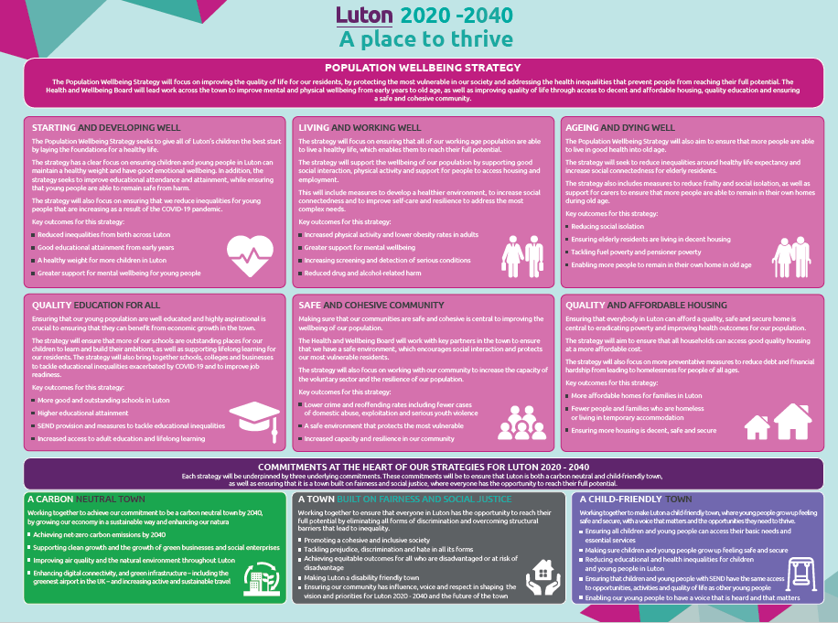
Luton 2020 – 2040: A place to thrive (1)

Slide 12


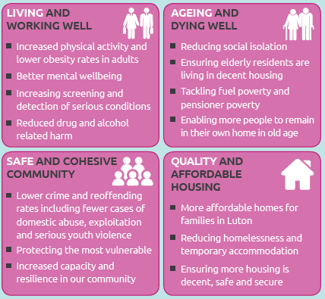

Luton 2020 – 2040: A place to thrive (2)
Proactive and early intervention for people who are frail and older to reduce social isolation and support people to live independently
Appropriate support for people with broader social care support needs and ensure housing is decent, safe and secure
Fewer households living in non-decent housing or temporary accommodation
Proactive engagement to provide greater support for mental wellbeing and reduced social isolation
A coordinated approach across services to reduce the number of cases of drug and alcohol related harm
Working collaboratively across the formal and informal sector to increase resilience and capacity in the community
More services delivered by or in partnership with community organisations

Slide 13
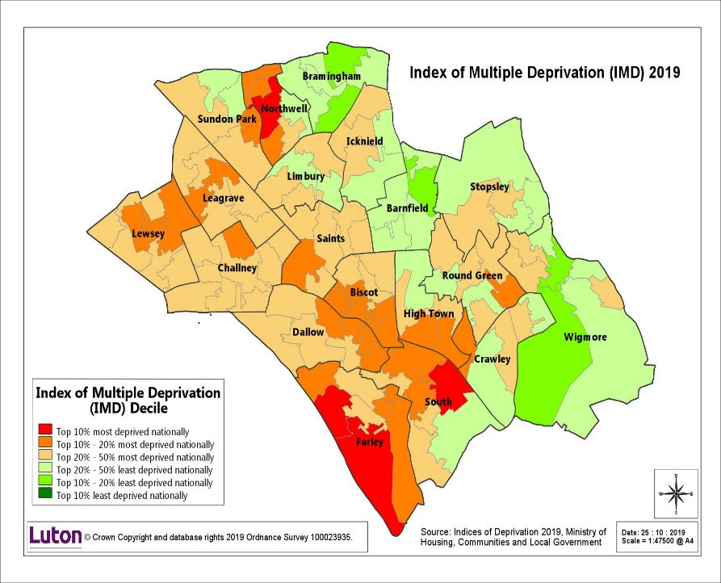
Luton’s population: 2020-2035 (1)
Luton is home to around 214,700 people and this is expected to increase by around 30,000 people over the next 20 years. Luton has a younger population profile relative to national averages, including the East of England average. However, the population is expected to grow across all age categories to 2035. Some of our key population characteristics include:
Luton is a super-diverse town and one of only three majority non White British towns in the UK
Luton has a large South Asian population and a growing Eastern European population
Luton has the 3rd youngest population in the country
High population churn with approximately 50% of population either not born or not living in Luton at the time of the 2011 Census
Luton’s population is projected to increase by 17 per cent in the next 20 years, with its fastest increase in the population of older people.
The map shows the most densely populated areas of Luton are in the centre of the town. With an area of 4,336 hectares, the ONS population figure translates into a population density of 48 people per hectare across the borough. This figure is greater than many London Boroughs.
We know that in Luton struggling households are situated in areas which fall amongst the top 10% deprived nationally (based on the index of multiple deprivation 2019). These areas are Farley, Northwell and South , highlighted in the map below.

Slide 14
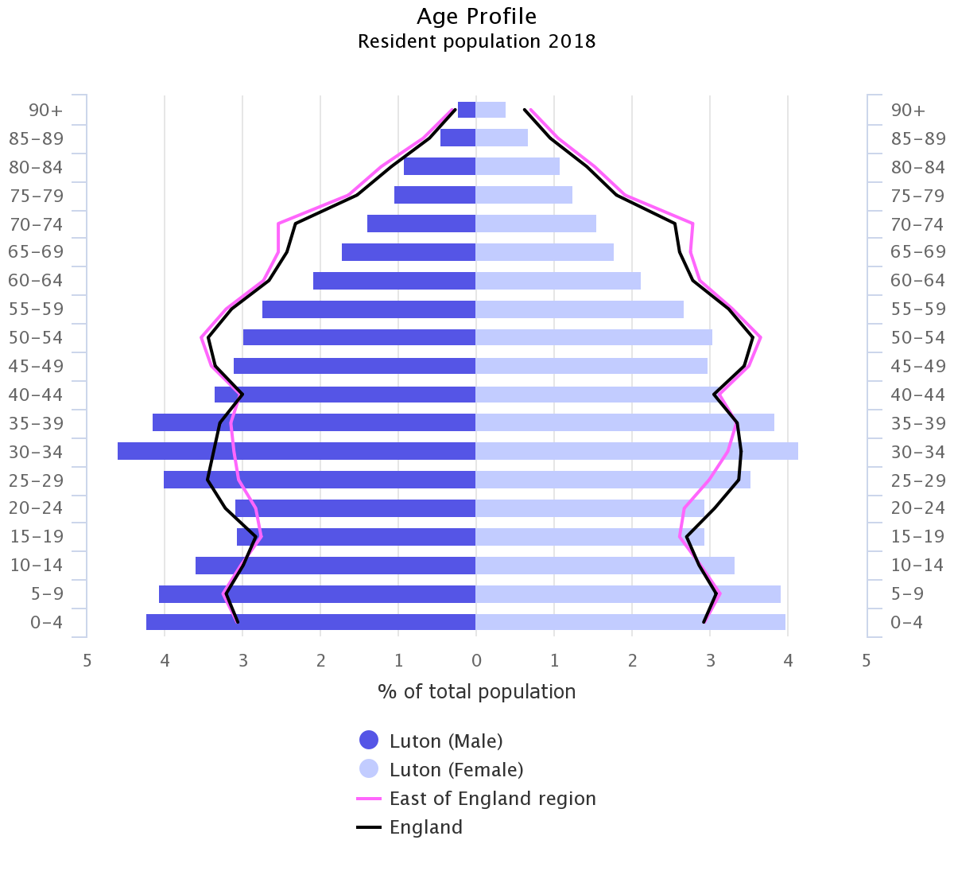
Luton’s population: 2020-2035 (2)
Population, projected to 2035 | 2020 | 2025 | 2030 | 2035
People aged 18-24 | 19,500 | 20,300 | 23,100 | 24,100
People aged 25-34 | 35,200 | 32,400 | 31,200 | 32,800
People aged 35-44 | 33,000 | 34,900 | 33,500 | 31,400
People aged 45-54 | 26,200 | 27,100 | 29,900 | 31,500
People aged 55-64 | 22,300 | 23,900 | 23,800 | 24,600
Total population aged 18-64 | 136,200 | 138,600 | 141,500 | 144,400
People aged 65-69 | 7,700 | 8,900 | 10,400 | 10,500
People aged 70-74 | 6,600 | 6,900 | 7,900 | 9,300
People aged 75-79 | 5,000 | 5,900 | 6,100 | 7,100
People aged 80-84 | 4,400 | 4,200 | 5,000 | 5,200
People aged 85-89 | 2,600 | 3,000 | 3,000 | 3,700
People aged 90 and over | 1,500 | 1,800 | 2,300 | 2,600
Total population 65 and over | 27,800 | 30,700 | 34,700 | 38,400
Total population - all ages | 223,800 | 230,900 | 236,700 | 242,000
Luton’s population pyramid shows age and gender of the resident population of Luton compared to the East of England and the whole of England and shows Luton has a younger population for both genders under the age of 45 years.
Figures may not sum due to rounding. Crown copyright 2018

Slide 15
Priorities for adult social care (1)
Priority | What will this involve? | What do we want the market to do?
1. Manage the impacts of Covid-19 with resilience planning across social care | Understand the impact of Covid-19 on need and demand of ASC (year on year comparisons of ASC service usage; total frail population; implications for demand, capacity, occupancy, financial sustainability and risk of provider failure) Develop Resilience Plans for Day Services, (including Transport) Home Care and Care Homes (including Nursing Beds), across commissioning, care management and quality Use Population Health information to shape service responses | We will work with: Providers who are able to provide quality and value for money Day Opportunities including employment and developmental options as alternatives to Day Centres for people with a learning disability. Providers to develop solutions to changing market need e.g. dual registration of residential/nursing homes Providers to understand and respond to the impact of Covid-19 on Adult Social Care services

Slide 16
Priorities for adult social care (2)
Priority | What will this involve? | What do we want the market to do?
2. Support people to live at home independently for as long as sensibly possible | Provide evidence based information that supports people to remain independent (e.g., Falls, Healthy living) Scope digital and assistive tech interventions that can support independence e.g. medication reminders Promoting access to direct payments and Pre Paid cards Community connections: Work in partnership with LCCG, CCS, Total Wellbeing and ELFT and voluntary sector organisations to support proactive and preventative programmes to support independence and wellbeing, such as Social Prescribing, Side by Side and Local Area Coordination and early-intervention (avoidance admission and rapid discharge) in frailty projects We will identify particular health risks that need to inform our preventative approach We will scope what skills this will require in our social care workforce and engage with the market to support this Improve care for those discharged from hospital with short-term rehabilitation needs | We will work with: Providers to support people to live independently (e.g. through workforce development, specialist requirements – including support for people with learning disability, independence strategies and connections in to their communities and digital solutions) Voluntary sector organisations to consider how they might work together and with system partners in ways including shared objectives, management teams and premises and how we can support this. Residential and Nursing Homes, Home Care providers and Voluntary Sector organisations about how they can assist with avoiding admissions, facilitating earlier discharges and improving the percentage of people who successfully complete reablement programmes

Slide 17
Priorities for adult social care (3)
Priority | What will this involve? | What do we want the market to do?
3. Test new approaches to delivering home care | Exploring principles for integrated health and social care models (such as those in the Buurtzorg model), in collaboration with the CCG, including working with providers to consider reducing overall care hours over time for people starting packages by using community approaches. This could apply to Reablement/Rehab services or people with longer term home care packages. Link with the Double up work (also linked to technology) | We will work with providers to: Explore the potential to use technology to remotely monitor people’s progress and scope the impact this has on care package hours and reducing double up visits Develop good practice in digital or technological approaches in home care Understand the impact of Covid on demand for home-care and how this might have a wider impact
4. Ensure Luton has the right supply of appropriate housing and accommodation for its changing demographic | A joined up approach across the Council, including with housing, social care and public health, to ensure the Luton population has the information and advice and choices available to support independent living Reduce the need for out of area placements due to unavailability of housing stock and accommodation supply in Luton and scope whether there is a supply challenge as a result of inadequate upstream support leading to avoidable demand Ensure provision is considered and appropriate for both singles and couples and families, across all groups Preventing homelessness through ensuring appropriate hostel provision for homeless Ensure sufficient and appropriate provision of sheltered housing Reviewing contract arrangements for housing that is not CQC registered | We will work with : Housing (and care providers) who are able to provide high quality, appropriate accommodation options at a cost that meets our value for money framework to support people to move back into Luton from out of area placements. We will scope the opportunity to work with the private sector to secure accommodation in borough. Providers to collaborate and use best practice around preventing homelessness and access to sheltered housing

Slide 18
Priorities for adult social care (4)
Priority | What will this involve? | What do we want the market to do?
5. Maintain and extend the expanded use of technology across social care settings | Build on innovations in remote support during Covid and more broadly to support activity such as placements, assessments/reassessments and potentially for some elements of the quality monitoring work e.g. the use of iPads in Care Homes and use of the Canary Assessment Tools Pilot further tech innovations in Sheltered Accommodation e.g. Alexa devices to prompt medication reminders Pilot extended tech use in people’s homes build on Care Lines products Scoping how use of direct payments can support independence through technology | We are interested in: Hearing from providers who have experience in supporting people through the use of technology in ways that support people to maintain their independence and improve monitoring and value for money Integrating good and best practice in digital and technological innovations into business as usual
6. Ensure Value for Money to contribute to Luton’s economic recovery plan | Review Out of Area Placements (particularly for people with a Learning Disability– residential and respite) to quantity numbers, gaps in provision and overall unmet need to identify necessary steps to return people to Luton, safely and sustainably – this will need to include broader consideration of the role of care placements Review contracting arrangements to move away from spot contracts to fixed terms to supply both stability for people in placements and opportunities for contracting at greater scale with financial efficiencies Ensure quality assurance and consistent due diligence across all services, including new providers Review overall placements process and activity to ensure value for money is secured Securing value for money through rolling out pre-payment cards for direct payments Changes in allocated hours for Housing Related Support (2021) Work with the Children’s team to align approaches with regard to frameworks and due diligence and value for money to support the process of transition in to adults social care | We will work with: Care (and housing) providers who are able to provide high quality personalised care at a cost that meets our value for money framework to support people to move back into Luton from out of area placements. Providers to improve quality assurance and due diligence processes in collaboration with Luton’s Quality Assurance & Care Placements Team

Slide 19
Priorities for adult social care (5)
Priority | What will this involve? | What do we want the market to do?
7. Support a coordinated and preventative approach to people with mental health and substance misuse issues | More integrated planning (given contracts are managed within separate teams) across relevant Council departments and stakeholders e.g. ResoLUTiONs, Penrose Synergy and STEPS Alignment with wider mental health strategies underway across Luton (Community Framework; Reimagining Mental Health | We will work with: Partners from across Luton to support people to become more integrated into their communities including work and developmental options A broad range of partners on the Reimagining Mental Health and Transforming Care programmes and on Implementation of the Dual Diagnosis Protocol
8. Support quality through strengthened quality assurance processes and developing the social care workforce | Revision to service quality reviews and escalation processes Support skill-development in the Social Care Workforce (links to CCS/CCG work, ADASS workforce strategy and BLMK workforce team, Council apprenticeship levy) including a specific management programme as well as service-specific training based on people with different needs Maximise benefit of PAMS tools as part of quality approaches Scope partnerships between clinical and social care workforce e.g. nursing apprenticeships to further develop carers Consider how training and quality approaches are sufficiently broad to be appropriate to range of providers (including non-commissioned services) | We will work with providers to: Engage and collaborate with our Quality Assurance and Care Placements Team as they undertake changes to quality assurance processes Take steps to improve recruitment and retention practices, including investment in workforce development We will work with providers, Skills for Care and the BLMK Workforce Team to develop programmes that support people to further develop their leadership skills and abilities and enable passporting of training and development between provider organisations

Slide 20
Collaboration and partnership working
People who use and are affected by adult social care services
We have Partnership groups that bring together people who use adult social care services. Some of those work better than others: we will be refreshing our approach to these to ensure a truly co-production approach to collaboration.
Working with others beyond Luton
Geographical boundaries can be artificial when considering how people are best supported through Adult Social Care. Luton Borough Council will be working closely with its neighbouring authorities within the Bedford, Luton, Milton Keynes (BLMK) Integrated Care System footprint to consider and address service areas that cross borders. Luton Council will also collaborate with colleagues across the East of England regional network to share and learn best practice approaches in adult social care, and understand the impacts of Covid-19 at a wider scale to act early to support our local market.
Public sector
These priorities will require a coordinated response across the Council (including Commissioning, Public Health, Social Care, Housing, Social Justice) as well as Luton Clinical Commissioning Group.
Provider network
Our Provider networks are critical and over the next 6 months we will be engaging with the sector and market to share this resource and discuss readiness for supporting Luton’s population with adult social care needs over the next 5 years, including discussing our shift to Preventative approaches and ambitions regard impact and metrics.
Third sector
We recognise the huge contribution made by the local voluntary and community sector in Luton, both formally commissioned and non-commissioned services. The impact of Covid-19 is significant: we want to work closely with our colleagues in the third sector to identify how best we can support them. Building on the strengths and assets in out community is integral to our future working – already prioritised through our Side by Side programme and Local Area Coordination.
What do we need to do?
Establish regular joint forums across the Council to collaborate on specific work areas and identify areas for increased financial control Engage with Providers and third sector to share our approach and vision and work together to understand opportunities and barriers Review our partnership forums to support co-production approaches Scope opportunities to share learning, insight and best practice across a wider geography (BMLK/EOE)

Slide 21
Carers
Carers Central holds an umbrella contract to support carers in Luton.
Luton has been working with a draft Carers strategy developed with partners and led by Carers Central that requires review. This will be a priority for Carers Central for 2021/22.
It is recognised that we are not reaching all those in Luton with caring responsibilities and we do not have accurate numbers to estimate the number of carers in Luton.
There is an evident challenge of under-identification of carers in Luton; approximately 1000 carer assessments are done annually in Luton however there are an estimated 18,000 carers in Luton (based on the 2011 census) and it is likely the number is much higher given that many do not self-identify as carers
Of the 9432 patients on the GP register who are identified as either frail, or a A&E high intensity user or living in a care home, 104 are identified as carers themselves
What do we need to do? | Next steps
Develop a long-term carers strategy, addressing the increased pressure on many carers during Covid-19 | Co-produce Carers strategy with carers, providers and CCG engagement as well as wider stakeholders e.g. Voluntary and Community Sector including ensuring proactive identification of carers Undertake a needs assessment to understand number of carers in Luton and their needs Consider use of Pre-Paid Cards for annual carers direct payment (where eligible)

Slide 22
Early and preventive support
Our community based operating model for adult social care services, including our Side by Side programme, is focused on strength-based conversations and collaboration with people, their families and carers. It aims to: (i) change the culture in ASC to focus more on people’s strengths, gifts and assets, (ii) bend the curve of demand and constrain costs and (iii) improve the experience of the ASC journey, eliminating queues, waiting lists and lengthy form-led assessments. This is at an early stage, but already we have seen positive change evidenced through good feedback from people using the service, and reductions in queues and waiting lists. We also seen evidence that early intervention and prevention, better triaging and more effective signposting, is reducing the level of activity required in long term care and complex case management.
In the 6 months between December 2019 to May 2020, 2196 people entered our Total Wellbeing social prescriptions programme; for one quarter of these people, the reason for referral related to their mental health. The remaining 75% were referred for other long-term conditions. Social workers can make referrals for social prescriptions. Under Covid joint working across adult social care, Active Luton and the primary care networks enabled a proactive approach to supporting those shielding as well as the frail and or vulnerable. Link workers are also supporting the delivery of Luton’s Side by Side programme and frailty management – for example, those identified by mild frail by the CCG or CCS will be approached and offered support to engage with appropriate physical activity opportunities which can prevent progression to moderate or severely frail. This model is currently being considered for long-term conditions including diabetes and respiratory issues, and may over time reduce overall need for adult social care.
Luton Council’s healthy lifestyles service is provided through Total Wellbeing, providing exercise referrals, stop smoking services, NHS health checks, rehabilitation programmes for those with long-term conditions, including supporting people with long-term conditions to be physically active, weight management programmes and social prescribing.
What do we need to do? | Next steps
Ensure that people are supported to connect positively with opportunities to participate, develop and grow in their communities to build resilience and maintain independence | Continue to develop these approaches in partnership with Active Luton and the Primary Care Networks Measure the impact of the approaches on demand for services Implement the Local Area Coordination project

Slide 23
Community Equipment and Assistive Technology
In 2019/20, the Council spend £272k to support 2,563 people with community equipment through Millbrook Healthcare.
Luton Council’s Lifelines commercial service services 1,200 people, providing lifeline support as well as additional sensors such as falls detectors, smoke and carbon monoxide detectors and epilepsy sensors.
By 2025, Luton will have completed a ‘digital switchover’ moving from analogue to digital and transferring our lifelines services over.
What do we need to do? | Next steps
The Council’s lifeline service will be working more closely with Adult Social Care services and the Public Health team in supporting people to live independently Widely adopt telecare to enable more people to live independently in their own home Transitioning our lifelines service over to digital e.g. developing pre-programmed equipment and set-up. | Build on the use of technology (iPads, Canary assessment tools etc.) to support activity such as placements, assessments/reassessments and potentially for some elements of the quality monitoring work) Pilot further tech innovations in Sheltered Accommodation e.g. Alexa devices to prompt medication reminders Pilot extended tech use in people’s homes building on Care Lines products Explore how assistive technology can increase independence in care settings and deliver value for money Continue digital switchover

Slide 24
Advocacy
Advocacy provision in Luton supports and enables individuals to exercise and safeguard their rights, express their views, explore and make informed choices.
Statutory Advocacy includes
  Independent Mental Capacity Advocacy (IMCA) including IMCA Deprivation of Liberty Safeguards (DOLS)* and Relevant Persons Paid Representative Service (RPPR)
  Independent Mental Health Advocacy (IMHA)
  NHS Complaints Advocacy
  Community Advocacy: Independent Advocacy, Information and Advice
Deprivation of Liberty (DOLS) is to be replaced by the Liberty Protection Safeguards (LPS) which became law May 2019. The target date for implementation is 1 April 2022.
Non-Statutory Advocacy includes:
  Independent advocacy for people who experience difficulty due to their mental or physical health, or have learning difficulties. This includes providing representation at meetings to support eligible people and offering advice, information and signposting.
Financial years | Nos of referrals for IMCA (includes PPR) | DOLs 39A/39C/39D and 1.2 support | Average no. of hours per week includes IMCA and PPR | Nos of referrals for IMHA | Nos of referral for Care Act advocacy | Nos of NHS Complaints Advocacy
April- June 2020 | 47 (42 people) | 12 | 41.4 | 44 (43 people) | 19 (18 people) | 13 (11 people)
2019 - 2020 | 250 (226 people) | 88 | 28.11 | 212 (188 people) | 78 (77 people) | 77 (72 people)
2018 - 2019 | 242 (215 people) | 101 | 23.3 | 203 (194 people) | 99 (87 people) | 70 (68 people)
The main group supported were people aged 60+. This is due to the majority of referrals for older people residing in Care homes, with age related disabilities.
What do we need to do? | Next steps?
Ensure independent advocacy services have the expertise to support people with complex communication needs | Continue to engage advocacy services to support patients across adult social care and respond to any feedback to ensure ongoing service improvement Transition from DOLS to LPS in line with national legislation

Slide 25
Direct Payments (1)
Breakdown of direct payment spend by group
Physical support - adults (18–64) | £2,899,792
Physical support - older people (65+) | £1,983,610
Sensory support - adults (18–64) | £145,796
Sensory support - older people (65+) | £38,223
Support with memory and cognition - adults (18–64) | £25,431
Support with memory and cognition – older people (65+) | £87,049
Learning disability support - adults (18–64) | £2,539,151
Learning disability support – older people (65+) | £11,963
Mental health support - adults (18–64) | £284,200
Mental health support – older people (65+) | £188,119
There are currently 738 recipients of direct payments in Luton at a total value of £8,203,333 (see table for further breakdown)
These are used to purchase a range of services, such as personal care, day care and support with social activities

Slide 26
Direct Payments (2)
Luton is supporting people to move from holding accounts for direct payments over to pre-paid cards; this will further strengthen financial governance, support data monitoring and introduce efficiencies
Luton will be supporting its direct payments people to push for value for money from services and will be reviewing its direct payment packages to ensure they are up-to-date and reflect current needs
Luton wants to support a preventative approach to its population health through good direct payments and ancillary services
Currently Individual Service Funds are not widely used in Luton
What do we need to do? | Next steps
Increase the number of people in receipt of direct payments, alongside its investment in asset-based approaches to community development and local support systems (e.g. Side by Side). Improve efficiency and governance of the direct payment process through introduction of pre-paid cards | Revise commissioning arrangements for the direct payments contract (scope all options and tendering approaches) Set up in-house provision for managed/holding accounts/pre-paid cards. Ongoing implementation of roll-out of pre-paid cards Scope potential for Individual Service Funds (ISFs) as a complementary offer alongside direct payments, and market solutions to this development Explore how direct payment users can take advantage of LBC contracts to secure competitive rates Scope linkages to other areas where training in eligibility for DPs is relevant e.g. for personal assistants for people with dementia Work with community-based and user-led sectors to develop a wide range of activities across all care groups with access to DP Seek to increase personal assistants from a range of genders, ethnicities and backgrounds in order to provide culturally sensitive services

Slide 27
Older People
Luton Council supported 2,949 people aged 65+ years (excluding carers) in 2019/20 with adult social care (short and long-term needs, including reablement and equipment services).
There are 27,800 people aged 65+ years in Luton in 2020, this is projected to increase to 38,400 by 2035 (POPPI).
22,000 of people over 65 are identified by the Electronic Frailty Index as Mild (~14800), Moderately (~4,500) or Severely Frail (~2,500) (frailty population index)
It is estimated that ~20,000 people in Luton over 65 may exhibit a long term and life limiting illness by 2035 increased from ~14,400 in 2020.
The HealthWatch engagement programme report for Luton in 2019 showed that 77% of people rated the option “I want to be able to stay in my own home as long as it is safe to do so” as very important and a further 21% said it was important
What do we need to do? | Next steps
Support older people’s preferences to live independently at home as far as possible Ensure good provision of step-down services to support longer-term independent living Work across housing, commissioning and business intelligence to quantify the impact on housing need of an ageing population with increasing morbidity alongside preventative interventions to support independent living Ensure complementary interventions (home care, social prescribing and Side by Side etc.) are equipped with information and advice related to ASC support for older people such as aids, adaptations, assistive tech | Scope impact of Covid on OP demand across service areas – what capacity we have in the market and what we will need Implement strategies to support people to live independently for as long as possible – e.g. digital/tech solutions, as well as community approaches (social prescribing, Side by Side, Networks of Wellbeing Groups, proactive information and advice) Scope impact on ASC support services of plans for housing provision (extra care/sheltered accommodation) e.g. how will it impact demand for domiciliary care / residential care

Slide 28
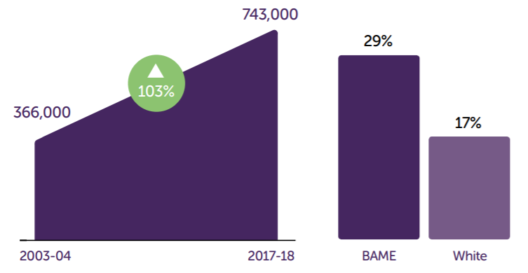
General and older person housing supply in Luton
In the last few years has experienced a 25% rise in property prices and private rents, which has led to an increase in demand for affordable homes particularly for low-income households. A recent study shows that Luton has seen an oversupply of one-bedroom properties and not enough family sized homes. Luton are working closely with partners to achieve a better balance of types of accommodation built in the town
Demand for care and support services for older people is likely to rise but will not be matched by levels of public spending over the next three to four years.
The rise in the older population is not just a challenge for social care but for our whole council and community.
Surveys show that older people do not wish to end their days in residential care.
Life expectancy is increasing and entry into all care services are likely to be later in life, but from people with more complex support needs.
Luton has a significant number of sheltered accommodation units, and some specialist housing schemes.
The population of older people with dementia is growing, and due to lack of community based alternatives, stay in hospital longer and we do not serve this population well enough.
(National) Number of private renters aged 55 and over [Centre for Ageing Better: The State of Ageing in 2019]
(National) Proportion of White and BAME households that are privately rented [Centre for Ageing Better: The State of Ageing in 2019]

Slide 29
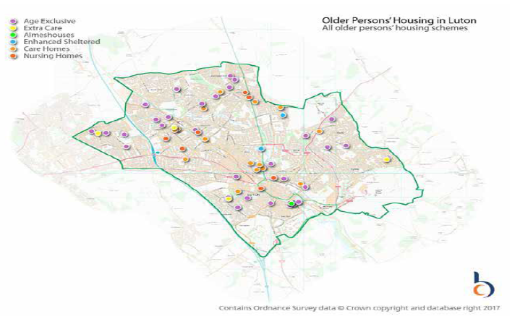
Older persons’ housing supply in Luton
Housing type | Definition
Age Exclusive housing | Housing aimed at older adults, both private developed, RSL and Council stock, including flats and bungalows. Most schemes include some form of community alarm but not usually a housing officer)
Almshouses | Accommodation specifically designated as an Almshouse (charitably-funded housing for older people)
Sheltered Housing | Private, RSL, or Council stock for older people that includes on-site or visiting support form a Sheltered Housing officer or scheme manager
Extra Care Housing | Purpose built housing with care schemes for older people, with an on-site care team providing care and support to some or all units
Care homes | CQC registered accommodation registered to provide personal care, only to older people (other people may be included in the registration)
Nursing homes | CQC registered accommodation registered to provide personal care and nursing care to older people

Slide 30
Domiciliary Care
In 2019/20, 900 (unique) people were supported with home care services commissioned by the Council. The cost of home care via external providers was £9,125,870 in 2019/20.
Luton’s domiciliary care contract was awarded in April 2018, with a duration of 5 years plus 1 plus 1.
Currently only one provider for hospital intake for domiciliary care.
In 2019/20 around 750 people* received reablement services with 91% considered ‘independent’ following reablement support.
The Council’s Side by Side Programme is proactively supporting people with low-level support needs to find more personalised, localised and cost-effective solutions to meeting their needs. This is complemented by programmes such as social prescribing. This approach may result in an overall decrease in the size of care packages, as practitioners identify alternative sources of support. There is also likely to be a delay and consequent reduction in the number of people seeking and receiving long term care due to better triaging and more effective signposting,
* Local reablement records indicate more referrals but LAS entries are slightly lower
What do we need to do? | Next steps
Increase the number of people receiving direct payments, to promote personalisation and enable choice Prepare for the rising ageing population in Luton Work with colleagues across commissioning and adult social care to quantify the impact on home care of increasing support for people to live independently at home for as long as possible | Develop Resilience Plans based on likely impact of Covid on home care Explore best practice examples of implementation of models with principles of home care integrated with community nursing e.g. the Buurtzorg model. Explore potential for digital/tech solutions or enhancements e.g. ‘just in case’ calls from home care providers Offer rehabilitation to support people to return to their baseline and continue to live independently Support Home Carers to develop their skills and passport these across organisations both with courses and contractual expectations.

Slide 31
Sheltered Accommodation and Extra Care housing (1)
The nature of the needs of people living in sheltered housing is changing over time, with an increasing number of younger people of working age as well as people with complex needs. The proportion of older people (of retirement age) in sheltered housing is decreasing.
Demand on sheltered accommodation is impacted by interventions which support people to stay living independently in their own home for longer, including access to assistive technology.
Some sheltered accommodation units have accessibility limits (e.g. no lifts available, or problems with location)
Some sheltered housing properties are located outside of main scheme buildings e.g. Abigail Close bungalows that are part of the Abigail Court sheltered housing scheme but are located separately. These are connected via a Call System and the tenants are subject to the same service offer with full accessibility to the main scheme.
Luton Council has a total of 2 extra care schemes with 91 units but does work in partnership with Homegroup (Applegrove) and Beds Pilgrims Housing Association (BPHA, Betty Dodd and Jill Jenkins Courts)
Luton Council has a total of 834 sheltered housing accommodation units and 91 Extra Care properties. In the past 12 months, we have had 100 vacancies in sheltered accommodation (this number reflects the impact of Covid and is not necessarily generalisable) (occupancy in March 2020 828 and in June 2020 786).
Luton has some sheltered accommodation (self-contained flats, with service provided by sheltered housing officers) that is harder to let (due to lack of facilities e.g. not wheelchair accessible or lack of step-free access) but in general the Council manages supply/demand. However, Luton lets a significant number of properties to applicants with low level housing needs but the demand from those with high level needs does not balance with supply. In order to increase demand, in the last few years the Council has decreased the age criteria.
Despite the number of voids there is still a waiting list for sheltered accommodation due to challenges of accessibility in some units of current provision
There are a high number of applicants who are eligible for sheltered housing but, as above, many of these applicants do not have high levels of housing or care needs.
All schemes are subject to a plan of refurbishments of which 15 of 20 have been completed.
Both Luton Council Extra Care Schemes are scheduled for refurbishment and system upgrades. These are scheduled for 2020-2021.

Slide 32
Sheltered Accommodation and Extra Care housing (2)
What do we need to do? | Next steps
Better understand the changing profile of sheltered accommodation across the range of schemes, including the levels of support that are provided into each of the schemes. Determine whether there are areas that need more supply Agree approach to engaging with suppliers of schemes where there is demand for more or less of specific kinds of supported accommodation | Scope and quantify the changes to sheltered accommodation and interdependencies with other aspects of provision (e.g. extra care, independent living) and implications for provision and demand in the future Explore potential for transitioning some sheltered accommodation units to age specific schemes (where the attributes of the block allow for this e.g. accessible, lifts installed etc.) Continue with the plan of scheme upgrades Investigate use of technology such as Tablets within tenants properties as a method to address social isolation. Promote and increase social inclusion within schemes as a method increasing social involvement. Look at ways to generate income from facilities following refurbishment.

Slide 33
Long Term Residential and Nursing Care (1)
In 2019/20, Luton supported 428 people (142 people aged 18-64yrs and 286 people aged 65+) in long-term residential care at a cost of £20,878,113. In addition, Luton Council spent £1,526,144 on short-term residential care. There are 703 residential care beds available. The Council paid for out of borough residential care for ~12 people.
In 2019/20, Luton supported 94 people (21 people aged 18-64yrs and 73 people aged 65+yrs) in long-term nursing care at a cost of £3,734,052. in addition, the Council spent £429,241 on short term nursing care. There are 350 nursing care beds available. The Council paid for out of borough nursing care for ~72 people.
Only one care home in Luton can provide respite care for people with severe physical disabilities
A rising proportion of residents with dementia with associated physical and mental health needs as a result.
Luton has 150 self-funders, making up 19% of the occupancy.
Based on analysis from July-September 2020, the void rate was at 22.5%, illustrating the challenges that COVID-19 has had on the market.
Defining residential and nursing care
Luton has an estimated over-supply of residential care beds, and an under-supply of nursing care beds, particularly for placing people with complex packages. There is a need for a shared understanding of how ‘nursing care’ is defined, between commissioners and providers.
Supply
Luton currently uses spot purchasing for all nursing and residential care
What do we need to do? | Next steps
Support older people’s preferences to live independently at home as far as possible, rather than in residential care Consider what can be done in Residential Beds (as opposed to Nursing Beds) with training and support from partners like CCS Agree what is within and outside core hours and what constitutes 1-1 support Work across housing, commissioning and business intelligence to quantify the impact on residential care future capacity needs of an ageing population with increasing morbidity alongside preventative interventions to support independent living including the impact of Covid Work with providers to consider how tech approaches could maximise people’s health and independence (e.g. NEWS iPads) Consider cost, volume and block contracts in certain areas of the market Determine what 'good' residential looks like - this could be ensuite bathrooms or level of activities and engagement , outcomes achieved by individuals or levels of staff competencies | Improve the process for placing people with complex need including having sufficient provision to reduce the number of out of borough placements Review the data to quantify need and supply to address any gaps in provision of care for people with severe physical disabilities including areas like tracheostomy care Explore models for enhanced services in residential care Explore dual residential and nursing home categories or workforce development to enable short-term nursing care in residential homes, to create more flex in capacity to place people and reduce waiting lists Develop Resilience Plans based on likely impact of Covid on residential care (e.g. over and under supply – consider right level of flex and market impact) Understanding and quantifying the self-funder market and any changes over time Explore viability of working age adults in out of borough placements returning to suitable local services

Slide 34
Long Term Residential and Nursing Care (2)
 | Nursing Homes (Long Stay) | Nursing Homes (Short Stay) | Residential Care Homes (Long Stay) | Residential Care Homes (Short Stay)
Physical support - adults (18–64) | £886,413 | £19,662 | £1,238,782 | £76,819
Physical support - older people (65+) | £1,493,535 | £297,959 | £5,601,329 | £525,136
Sensory support - adults (18–64)
Sensory support – older people (65+) |  |  | £31,508 | £0
Support with memory and cognition - adults (18–64)
Support with memory and cognition – older people (65+) | £93,185 | £271 | £607,456 | £32,014
Learning disability support - adults (18–64) | £380,335 | £14,815 | £8,336,492 | £125,802
Learning disability support – older people (65+) | £71,996 |  | £227,317 | £7,079
Mental health support - adults (18–64) | £229,306 |  | £2,950,923 | £580,481
Mental health support - older people (65+) | £579,282 | £96,534 | £1,884,307 | £178,813
Grand Total | £3,734,052 | £429,241 | £20,878,113 | £1,526,144

Slide 35
Mental Health (1)
It is estimated that in 20202, 25,582 people aged 18-64yrs in Luton have a common mental health disorder, and that 9,795 have two or more psychiatric disorders [PANSI]
The Total Wellbeing programme provides IAPT and Luton’s health lifestyles services. ELFT provides Luton’s Mental Health and Wellbeing Service including community and in-patient services.
Luton has had to secure out of borough supported living arrangements for up to 10 people over the last 2 years, due to inadequate supply within Luton.
People who use Luton’s mental health services have told us they do not want to bounce between services. Luton’s Reimagining Mental Health programme is piloting an ‘open access’ pathway, to provide a multi-agency approach to individuals on that mental health pathway, regardless of their contact point with the system. Other programmes such as Side by Side and Local Area Coordination, as well as Social Prescribing, will improve our community-based support aiming to provide an upstream preventative intervention.
A lot of social care packages for mental health support are done through direct payments and Personal Assistants - small scale support that means a lot
The HealthWatch 2019 report into Luton’s healthcare services showed that people wanted to say more support in prevention and early intervention in mental health, better awareness of available services and reduced waiting times. There was some positive feedback about care coordination but some suggestions to improve managing relationships more robustly through transition

Slide 36
Mental Health (2)
What do we need to do? | Next steps
Resolve data interoperability issues across the MH system in order to monitor and track trends, shifts, numbers, needs. Create a proactive approach between MH social workers and housing to provide tailored solutions Develop more open channels of communication from MH team to understand pipeline of demand Work in partnership with the CCG and stakeholders (including providers and service-users) across health to ensure a joined up approach Ensure training and competency across all care settings e.g. motivational interviewing, trauma-informed approaches and understanding and dealing with mental capacity Review level of Housing Related Support provision Ensure sufficient Supported Living providers in Luton have capacity to support people with mental health needs – to prevent out of borough placements There is still both duplication and gaps in our current services: we want to streamline through joined up working and identify and reduce potential for people to fall between the gaps Scope resources to expand programmes to meet unmet need (e.g. Personality Disorder) | Build on the developments of Reimagining Mental Health to improve partnership working across stakeholders involved across the mental health pathway, including ensuring early offers of lower level community support e.g. Side by Side or Local Area Coordination Scope options such as peer-led support, access to employment and training for those who want jobs Scope need and solution for providing age-appropriate accommodation for young people with complex mental health needs (in partnership with BLMK colleagues) – including transition planning Develop a move on policy for those with MH in temporary accommodation and wrap around support (housing) Consider workforce skills to support individuals with complex needs Build on the existing ISA (secure relevant additional signatories) to ensure an integrated view of data across health and social care needs for mental health Scope digital / IT solutions e.g. interoperability between Rio (ELFT) and Liquid Logic (LBC), access to System One for key stakeholders - then review data and business intelligence for evidenced-based service improvements Scope designated resource within LBC to support liaison between MH social work and housing Scope possibility of a quota within the Housing Department for housing for people with adult social care needs, including people with mental health needs. Scope internal appetite for market solutions to provide more flexible support e.g. like floating support Scope appropriate tenancy options and explore providers with experience in MH/ASD/learning disability support Scope peer-led support offers for increasing resilience Review and update Luton’s mental health needs assessment Include workforce training and competency in trauma-informed approaches and mental capacity in ASC contracts and quality review ASC team to recruit a lead for therapies and assistive technology to drive forward this work, in collaboration with the commissioning team

Slide 37
Substance Misuse
1,209 people in treatment via ResoLUTiONs in last 12 months for opiates (694), non-opiates (81), alcohol (298) or alcohol and non-opiates (136).
A Dual Diagnosis Protocol is now in place with the Total Wellbeing Programme and ELFT to work together for identified individuals, so that one agency can take a lead with each person.
What do we need to do? | Next steps
Resolve data sharing challenges to in order to have a jointed up approach to monitoring and track trends, shifts, numbers, needs Embed the dual diagnosis protocol in frontline working Work in partnership with the CCG and stakeholders across health to ensure a joined up approach Secure frontline awareness and buy-in for the Dual Diagnosis protocol to develop clear pathways for implementation Ensure training and competency across all care settings e.g. motivational interviewing and trauma-informed approaches | Scope the impact of Covid-19 on numbers of people with substance misuse issues and dual diagnosis, and consequent impact on services and future needs Scope digital / IT solutions for data sharing Develop robust governance framework to operationalise the delivery of the shared protocol e.g. regular meetings to discuss cases together, clear governance arrangements etc. Work with the providers to scope longer-term solutions such as co-located offices, or co-commissioning of services. Include workforce training and competency in trauma-informed approaches, ASC contracts and quality review Scope availability of detox residential placements

Slide 38
Dementia
The current dementia strategy (co-produced with Dementia Action Alliance) runs to 2021.
There are an estimated 2,020 people aged 65+ years diagnosed with dementia. By 2035, Luton is likely to have 2,911 people aged 65+ years living with dementia. It is estimated that there are approximately 2,000 people living with cognitive impairment who are not diagnosed.
There are 723 people identified with dementia on Luton’s frailty patient risk tool
As the number of people in Luton with a learning disability increases year on year, with rising life expectancy, we anticipate an increasing number of people with a learning disability diagnosed with dementia
A new Cambridgeshire Community Services dementia specialist service is being piloted, integrated with ELFT’s dementia care service – it currently supports a caseload of ~200 people with moderate or severe dementia
We know that people with dementia stay in hospital longer due to lack of appropriate community provision
During Covid-19, the closure of day centres and unavailability of respite has increased pressure on people with dementia and their carers
It is a contractual requirement for dementia training across all commissioned adult social care services
What do we need to do? | Next steps
Ensure provision of community-based alternatives to extended stays in hospital Support people living with dementia to live independently at home as far as possible Ensure good provision of step-down services to support longer-term independent living Increase the number of referrals for Direct Payments and Personal Assistants Work across housing, commissioning and business intelligence to quantify the impact on housing need of a rising population with dementia alongside early interventions to support independent living Ensure complementary interventions (social prescribing, Side by Side etc. are equipped with information and advice related to ASC support) such as aids, adaptations, assistive tech | New Dementia Strategy to be co-produced with Dementia Action Alliance, in collaboration with the CCG and other stakeholders to ensure join up approach across care settings Support advanced care planning for people with dementia Training for clinical and social care professionals in supporting people with dementia, including Advance Care Planning and referrals for appropriate support via Direct Payments and pre-paid cards Develop Covid-19 resilience plans for day centres across Support training for staff working with people with learning disability to be equipped to detect early dementia symptoms in people with learning disability

Slide 39
Learning Disability and
Autism Spectrum Disorder (1)
The Council spends in total circa £12.6M on services to meets the needs of people with a learning disability and/or autism.
Luton Council supported 568 adults with learning disabilities as their primary support reason in 2019/20
There are over 3,886 people (18yrs+) with a learning disability in Luton in 2020 and this is set to increase to 4,361 by the year 2035 [PANSI] .
There are 1,652 people with autism spectrum disorder in Luton in 2020 and this is predicted to increase to 1,861 by 2035 [PANSI]
There are 33 people with learning disability/autistic spectrum disorder who are placed out of borough because their needs can not be met within Luton
While the overall age of Luton’s population is young there is an increase in the number of people growing older with a learning disability. There are more males in the younger age group accessing services. 50% of adults with a learning disability are from a White British background the ethnicity of those under 18 is more mixed with around 30% from White British and 30% from Pakistani backgrounds.
The majority of Luton adults with a Learning Disability who are receiving social care support are living at home with family or carers. 90% are in Luton and 10% live out of area
Housing
A learning disability / autism spectrum disorder market position statement has been drafted that sets out specific requirements for appropriate housing. Currently housing needs are largely general with support rather than bespoke housing
Between 2015/16 and 2017/18, supported Living placements for people with Learning Disability increased from 150 to 222 placements the largest increase (48%) across placement types. This is due to a change in the preferred accommodation model as well and a change in presenting need through young people coming through transition and reviews from existing placements.
Contracts for accommodation based support in Luton are either on a tendered fixed term contract or on spot purchased agreements. Fixed term contracts are used for people with more consistent needs and spot contracts used where people cannot be met in existing placement contracts. There are some people with a learning disability and autism in fixed term spot contracts but people with autism with no learning disabilities are in spot contracts due to the flexible and individualised requirements.
Luton Council gives preference to working with registered providers e.g. Regulator of Social Housing for housing providers and landlords, and Care Quality Commission for health and social care providers.
Luton prefers that providers of housing and care are separate. This may mean working alongside partner suppliers or providing housing and care provision through separate business entities. This protects the choice and control options for people requiring services.
There is a mixed provision of accommodation: (i) LBC owned property with LBC care provision, provider care provision or no care provision; (ii) Property owned or leased by providers with their care provision, (iii) Property owned or leased by housing associations with a different providers care provision or no care provision; (iv) Private land lord accommodation with a provider care provision or no care provision and (v) Private homes shared with people with a learning disability and or autism.
In the last 5 years there have been two Luton Council owned and two provider owned or leased supported living provisions created for learning disability but no new residential care provision created.
Opportunity for new builds for property for learning disability and autism care needs comes predominantly on the redevelopment of buildings, infill sites or section 106 developments. Increasingly new provision is created by making adaptions to existing property. LBC repurposed at 3 suites at Abigail Court (over persons extra care) for learning disability, with up to 2 years license, and monitoring in place to ensure progression.

Slide 40
Learning Disability and
Autism Spectrum Disorder (2)
What do we need to do? | Next steps
Learning disability specific Deliver the joint LBC LCCG learning disability Strategy Autism Spectrum Disorder specific Develop a neuro-diversity strategy to separate out focus on learning disability and autism including disaggregating data Learning disability & Autism Spectrum Disorder Support people to live independently at home as far as possible. Independence is the highest goal in accommodation-based packages. Where possible own tenancy is the preferred option, however in certain cases license arrangements maybe more useful. Enabling personalisation and choice for people to live where and with whom they want Ensure suitable housing: Provision should reflect the diverse needs across the ethnicity of Luton’s population Supporting seamless transitions, particularly targeting young adults returning to Luton from out-of-borough educational placements Reduce reliance on residential care and out-of-area placements. Some supported living schemes need remodelling or are no longer appropriate (properties are in poor condition or too many are shared units or are widely dispersed) | Learning disability specific Deliver the joint LBC LCCG learning disability Strategy Ensure sufficient, appropriate (can accommodate physical disabilities as well) and flexible (range of timescales) respite care is available Scope support to elderly parents reluctant for adult children to move on to residential support Ensure Providers are aware of and equipped to address safeguarding issues e.g. ‘cuckooing’ Scope impact of growing population on domiciliary care demand Autism Spectrum Disorder specific Co-produce a specific neuro-diversity strategy and action plan, to include a community awareness component (e.g. similar to community ‘Dementia friends’), and support across the pathway (including information for those losing support as a result of transition to adulthood) Improve quality and completeness of the autism risk register to support prevention and avoidable hospital admission (enable clear communication between mental health and commissioning) Provide a floating / crisis support offer to support early intervention/preventative action Learning disability & Autism Spectrum Disorder Maintain commitment to 2 projects a year to accommodate 10-12 additional people, with consideration of the need amongst singles, couples and families Ensure provision of support for those with low-level ongoing support needs regarding maintain tenancy (e.g. those moving on from Abigail Court) Connect in with parallel community provision (social prescribing, Side by Side) to support people to live independently for as long as possible Ensure sufficient provision for residential care placements within Luton (to reduce the current 33 OOB placements), including supporting transition to adults services (working across BLMK) Agree within the Housing team’s allocation policy for a number of units per year to be made available within residential stock Commissioning, adult social care team and housing to collaborate on capital bid for acquisitions Review contracting arrangements to move away from spot contracts to fixed terms to supply both stability for people in placements and opportunities for contracting at greater scale with financial efficiencies Consider workforce skills to support individuals with complex needs Support seamless transitions for people with SEND: creating a ‘lead professional role’ to ensure people transition only tell their story once; create a transitions checklist; survey young people transitioning to understand experiences; update a local offer (information hub) for SEND, streamlining processes sharing information between children’s and adults.

Slide 41
Day Services
In 2019/20, Luton Council commissioned day care support for 547 people. Of the approximately 750 people who receive direct payments, some will spend all or a proportion on day care.
Across Luton, there are currently 27 providers of day services providing services to 390 people.
Luton Borough Council spends £1,584,558 on external provision of day care services and £4,500,505 on in-house provision of day care
Day care | External | Internal
Physical support - adults (18–64) | £294,422 | £376,197
Physical support – older people (65+) | £30,626 | £1,186,747
Sensory support - adults (18–64) | £841 | -
Support with memory and cognition: adults (18–64) | £17,630 | -
Support with memory and cognition: older people (65+) | £4,140 | £415,235
Learning disability support - adults (18–64) | £1,236,898 | £2,505,867
Commissioning & Service Delivery | - | £16,459
What do we need to do? | Next steps
Direct payments to focus on an enablement approach which supports people to be more independent to reach their goals and inspirations reducing the need for direct payment support Prepare for the rising ageing population in Luton Work with colleagues across commissioning and adult social care to quantify the impact on day care of increasing support for people to live independently at home for as long as possible Consider options for pooled direct payments for people who have similar needs and interests, beneficial in terms of people developing friendships and a social circle as well as being cost effective | Develop Resilience Plans based on likely impact of Covid on provision of day services e.g. providing support that allows for social distancing Day opportunity services to be remodelled to a more flexible offer which potentially includes evenings, weekends and purchasing bite sized sessions Day services to focus on enabling people to progress and move on from services to enable people to fulfil their aspirations and manage demand

Slide 42
Supported Living
During 2019/20, 158 people were helped with supported living arrangements.
The Council spends £5.7m on supported living with providers providing a range of accommodation, from small facilities (2-6 people) to accommodation for 20+ people.
The Council does have a challenge with the provision of specialist supported accommodation for people with complex needs; there is insufficient stock to accommodate people with complex needs. There are high numbers of requests for people with learning disability and complex needs but low availability.
What do we need to do? | Next steps
Co-produce service specification with providers in the future Greater understanding of what provision is available for learning disability and complex needs | Consider what specific services will be needed for people with dual diagnosis Review needs for specific services to meet the needs of service users with physical disabilities e.g. ground floor provision and adaptions. Agree within the Housing team’s allocation policy for a number of units per year to be made available for people with ASC needs from the Council’s residential stock, within a wider agreement to support corporate priorities Commissioning, ASC team and housing to collaborate and scope a capital bid for acquisitions

Slide 43
Physical Disabilities, Sensory Impairment, Acquired Brian Injury
During 2019/20, Luton’s Adult Social Care services supported 758 people with physical support ‘personal care support’ and 792 people with physical support ‘access and mobility only’ as their primary support reason.
During 2019/20, Luton’s Adult Social Care services supported:
  18 people with ‘Sensory support: support for visual impairment’
  3 people with ‘Sensory support – Support for Dual impairment’
  5 people with sensory support – support for hearing impairment
 | ASC for adults 18-64 with 'physical support' needs | ASC for older people 65+ with 'physical support' needs
Daycare (internal and external) | £670,619 | £1,217,374
Homecare | £1,265,705 | £7,153,654
Direct payments | £2,899,792 | £1,983,610
 | ASC for sensory support adults 18 -64yrs | ASC for sensory support – older people (65+)
Day care (external) | £841
Homecare | £18,525 | £4,787
Direct payments | £145,796 | £38,223
 | 2020 | 2025 | 2030 | 2035
People aged 18-24 predicted to have a moderate or serious personal care disability | 195 | 203 | 231 | 241
People aged 25-34 predicted to have a moderate or serious personal care disability | 634 | 584 | 562 | 590
People aged 35-44 predicted to have a moderate or serious personal care disability | 1,155 | 1,221 | 1,173 | 1,099
People aged 45-54 predicted to have a moderate or serious personal care disability | 1,572 | 1,626 | 1,794 | 1,891
People aged 55-64 predicted to have a moderate or serious personal care disability | 2,341 | 2,509 | 2,499 | 2,583
Total population aged 18-64 predicted to have a moderate or serious personal care disability | 5,897 | 6,144 | 6,258 | 6,404​
What do we need to do? | Next steps
Develop work-plans to scope adult social care support for these areas | Scope relevant strategies for these areas of work Scope support offer to people with sensory impairment who do not have a diagnosis of learning disability or ASD

Slide 44
Quality and workforce
The Council uses the ADASS framework for quality and Provider Assessment and Market Management System (PAMS) for assessment and online monitoring
Testing revised approach to escalation procedure (for inadequate or requires improvement)
Currently have significant flux in the workforce
Luton Borough Council quality assure 77 services (12 services in Domiciliary Care, 13 residential services for people with learning disability, 6 nursing homes, 15 residential care homes, 7 mental health services, and 24 non-statutory services)
Of residential care homes, the CQC ratings are: 1 x Outstanding, 60 x Good (including 35 domiciliary care), 14 x Requires Improvement (including 4 Domiciliary care) and 3 x Inadequate (as of Dec 2020).
What do we need to do? | Next steps
The Council will be strengthening its approach to quality assurance in ASC Balance support with a drive for accountability and sustainability Invest in workforce development to improve retention | Service Reviews will bring together a range of information, include softer intelligence from health and social care professionals Scope approaches to quality assurance for services not commissioned through the Council Review of escalation procedure. Provider failure plan to be implemented. Programme of support for providers to encourage Sustainability of Quality in the market Review of recruitment and retention and development of registered managers. Wider workforce development support (e.g. subsidising training, development pathway, upskilling staff, explore value based recruitment, promoting managing and service-specific training opportunities) Build on progress during C-19 of strengthened relationships with providers with Partners (e.g. aligned social workers, PCN networks) Consider how training and quality approaches are sufficiently broad to be appropriate to range of providers (including non-commissioned services)

Slide 45
Procurement
Luton’s Prosperity through Procurement focuses on achieving significantly improved outcomes in our community through the Council’s purchasing and commissioning activities. This applies across Luton’s Adult Social Care services.
What do we need to do? | Next steps
Use our procurement processes to promote local prosperity and encourage small providers | When letting social care contracts, look to: Encourage suppliers to employ local people Where appropriate on large value contacts (procured in line with the Public Contract Regulations 2015) to use local sub-contractors Ensure providers have a Social Value Framework to ensure that additional benefits are delivered from relevant tender activity Diversify our supply chain Support small and medium sized businesses to engage with the public sector through a programme of engagement events to help promote ways that local suppliers can participate in tenders and look to remove some of the barriers. Ensure that all opportunities are published on our e-tendering portal to maximise interest and competition. Encourage providers to work on an open-book basis to really assist and develop and support to be sustainable in the market Lighter touch procurement approaches e.g. using Dynamic Purchasing System (e.g. framework to draw down on but can on-board once a year) Review spot and block purchasing Consider inclusion of prevention approaches within tenders

